Slide 1
Reinforcement Learning for Microgrid Optimization
Dr. Nicholas Flann

Slide 2
Problem: Optimal Charge/Discharge schedule
Given:
Source/load physical configuration
Given Data
Time-series weather data
Time-series source/load data
Time-of-day energy price
Given Models:
Battery operational cost function
Source and Load prediction
Find:
Battery charge/discharge schedule
Such that:
The value of electricity bought and sold is maximized
The cost of operating the battery is minimized

Slide 3
Solution: Reinforcement Learning
Exploits both models and data
Extensible to:
Complex multi-battery, multi-source configurations
Learning from experience for customization
Integration of solar energy prediction from weather
Complex buy/sell models including demand charges
User specifies reward functions
Rapid prototyping in Python
Scheduler is fitness function for the design optimizer

Slide 4
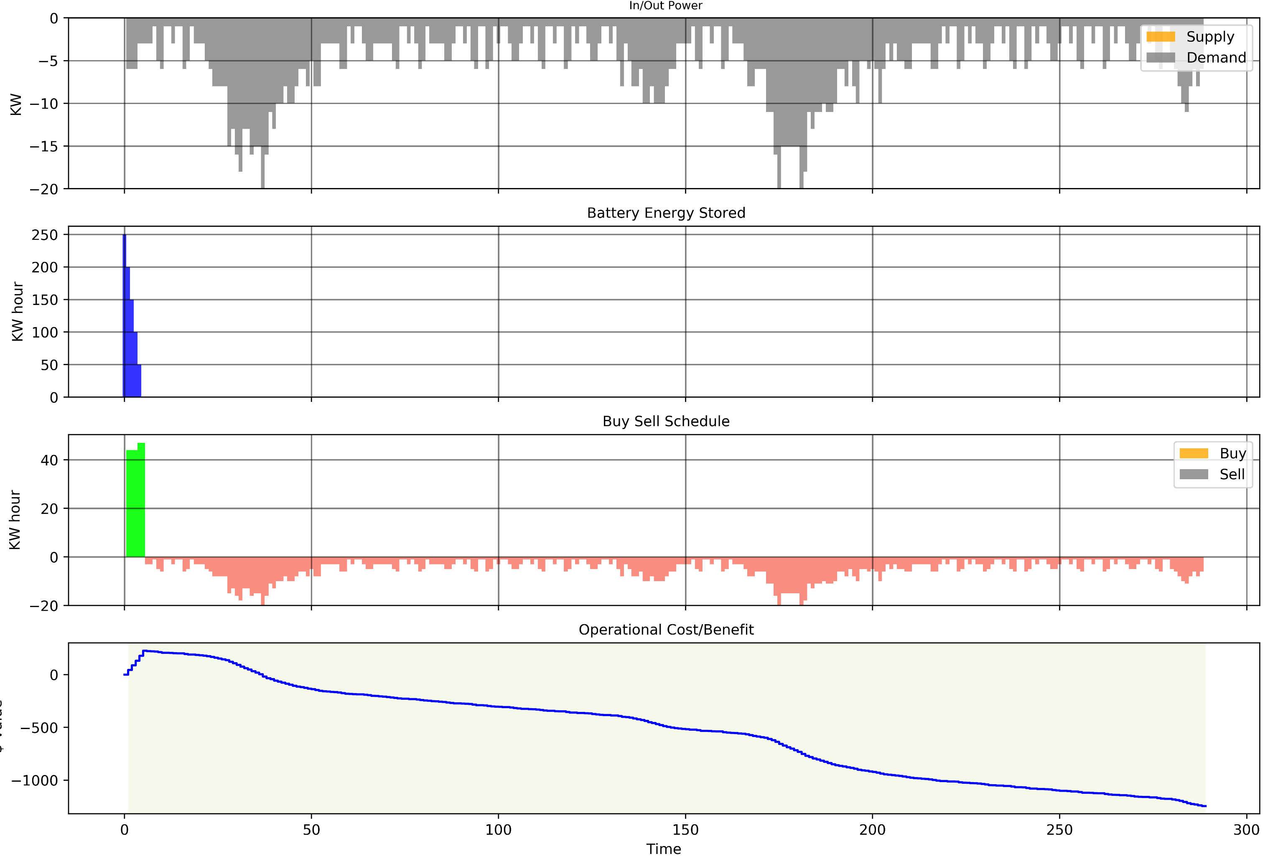
Simple Schedule: No solar, no TOD pricing, Complex Load Prediction

Slide 5
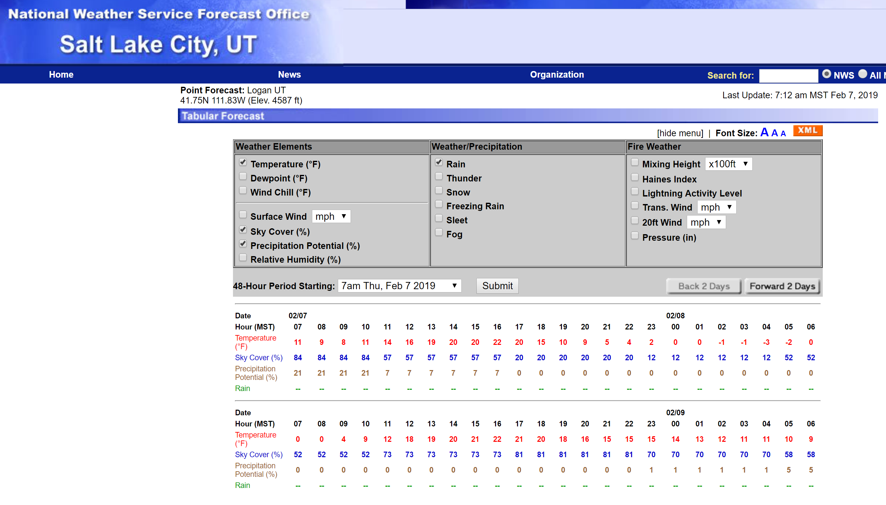
Add Solar Energy Prediction
http://forecast.weather.gov/MapClick.php?w0=t&w3u=1&w4=sky&w5=pop&w7=rain&AheadHour=0&Submit=Submit&FcstType=digital&lat=41.74290000000008&lon=-111.82256999999998&site=all&unit=0&dd=&bw=

Slide 6
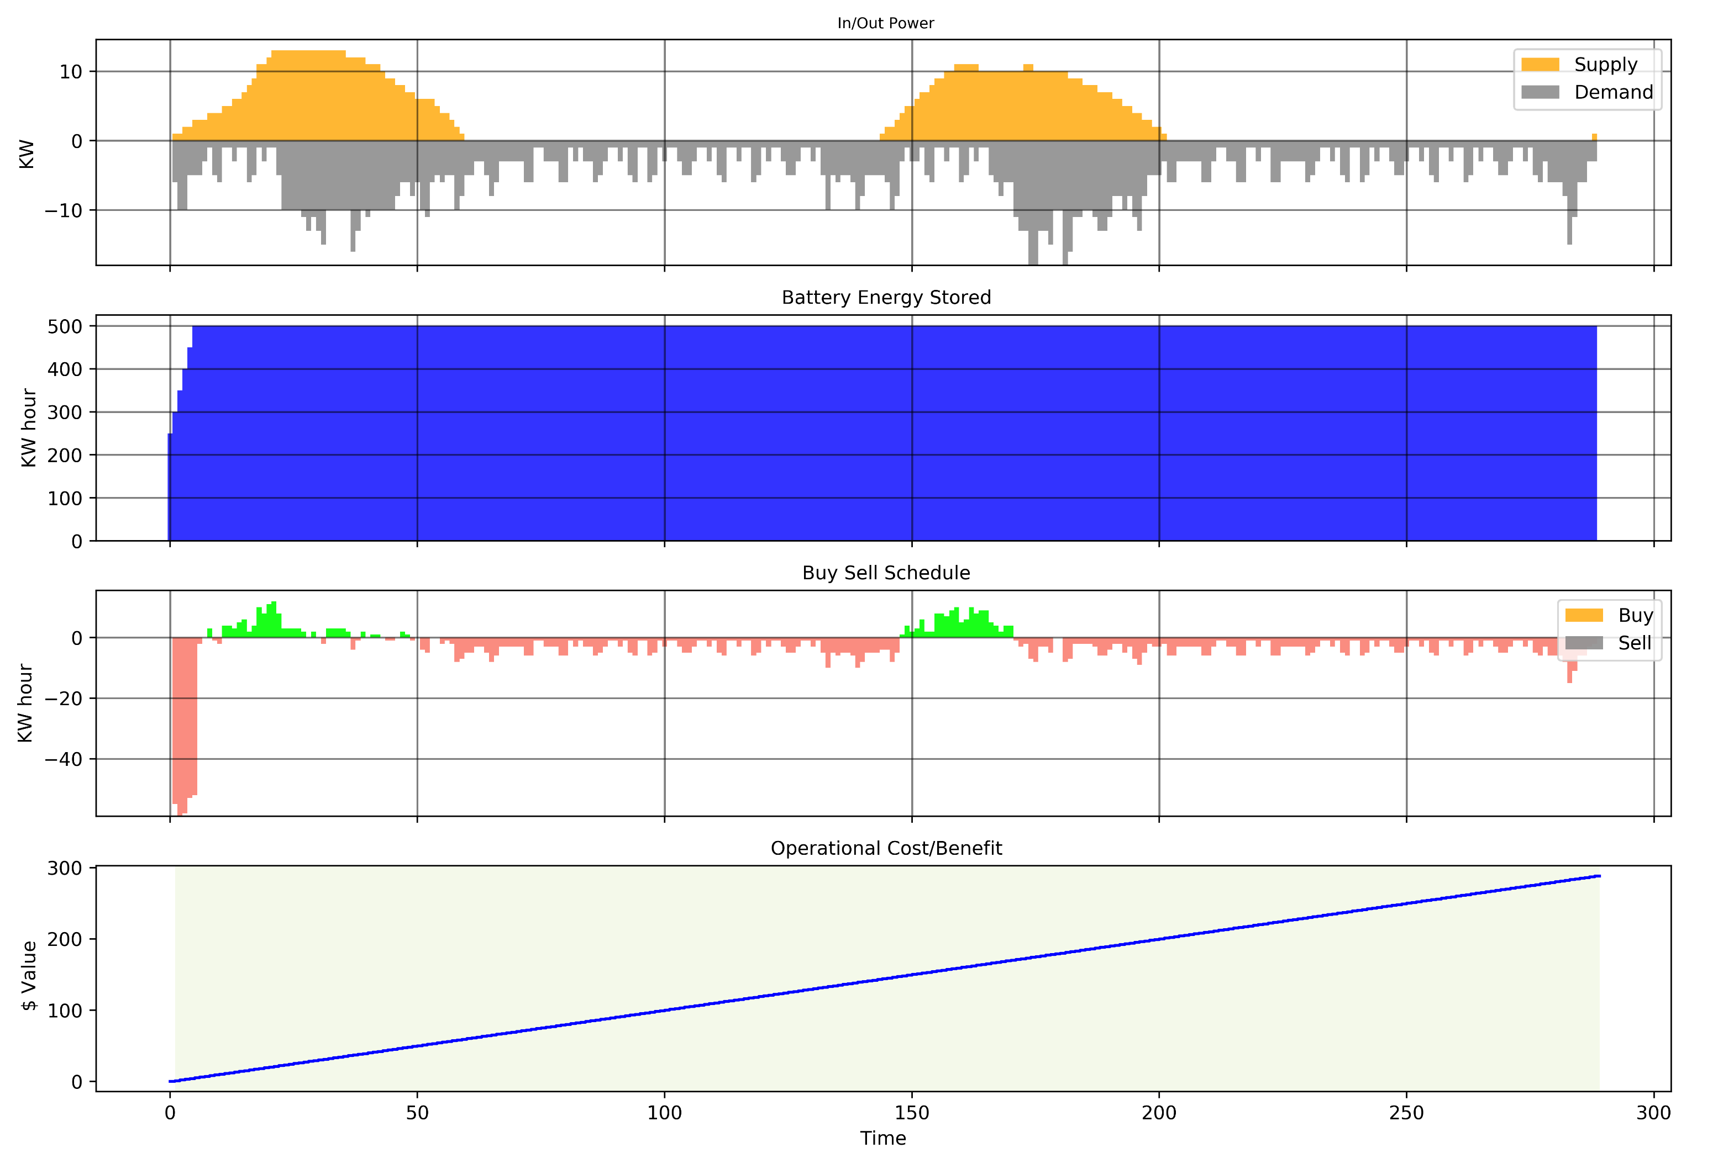
Schedule with Solar

Slide 7
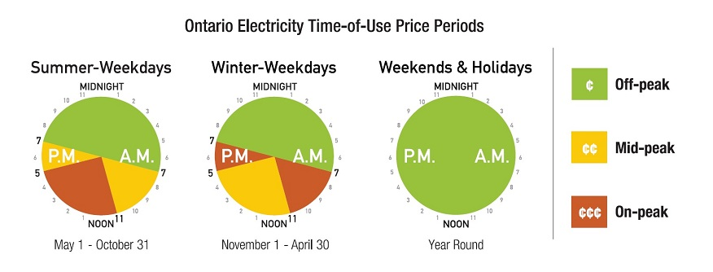
Add time of day pricing

Slide 8
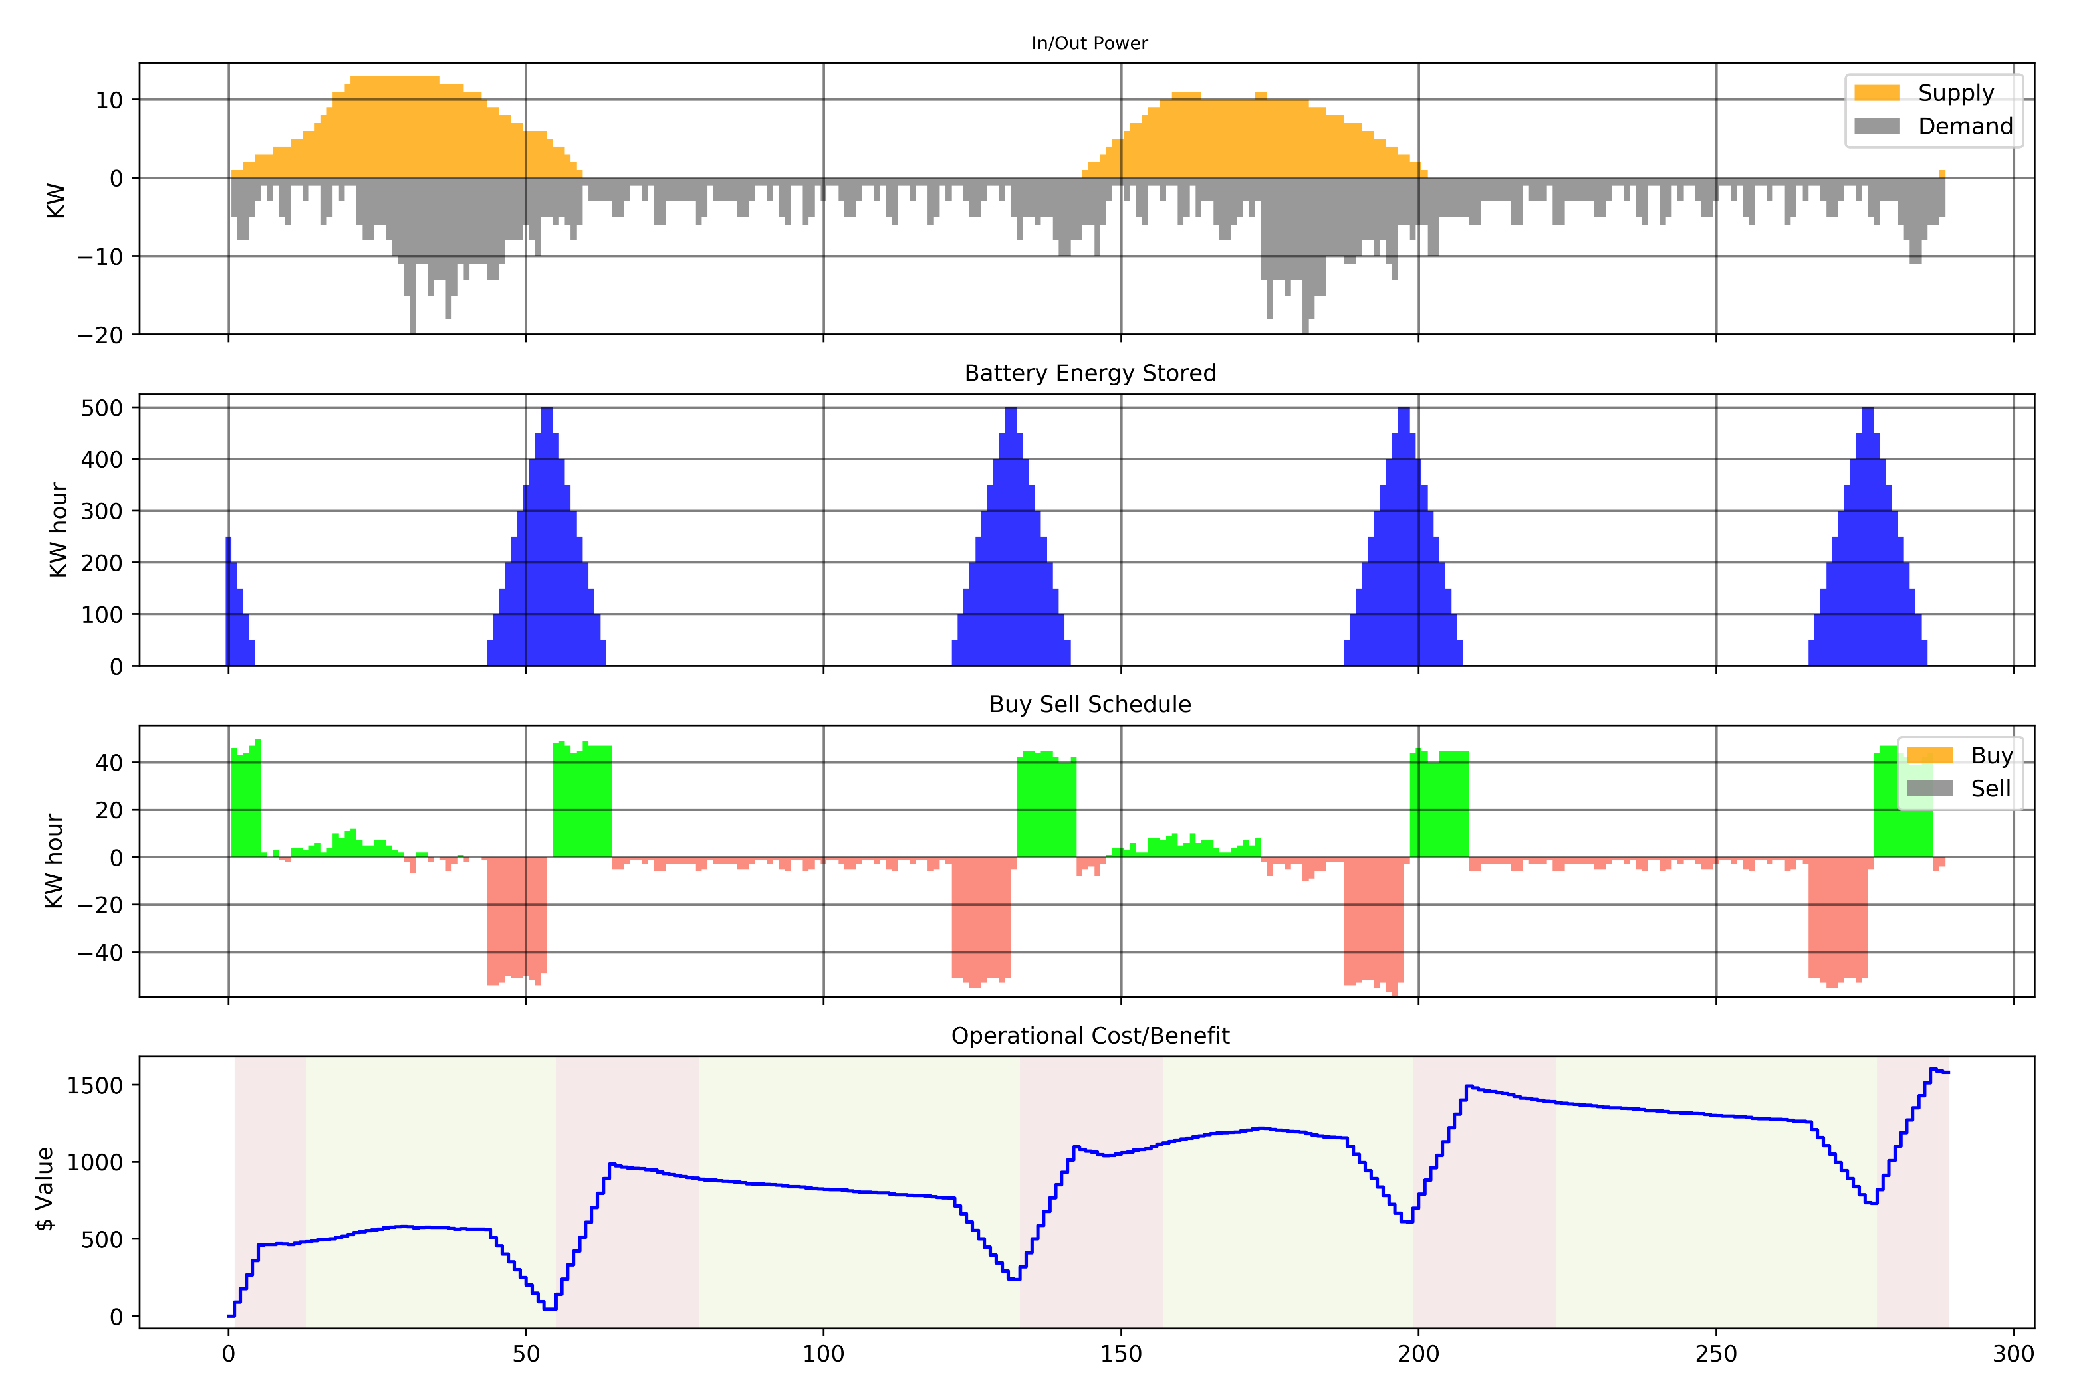
Schedule with TOD pricing

Slide 9
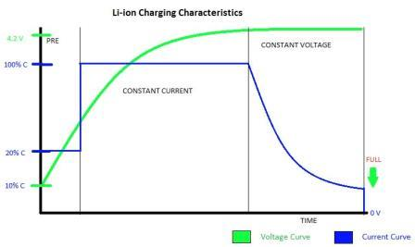
https://e2e.ti.com/blogs_/b/analogwire/archive/2017/06/15/precise-constant-current-regulation-helps-advance-fast-charging

Slide 10
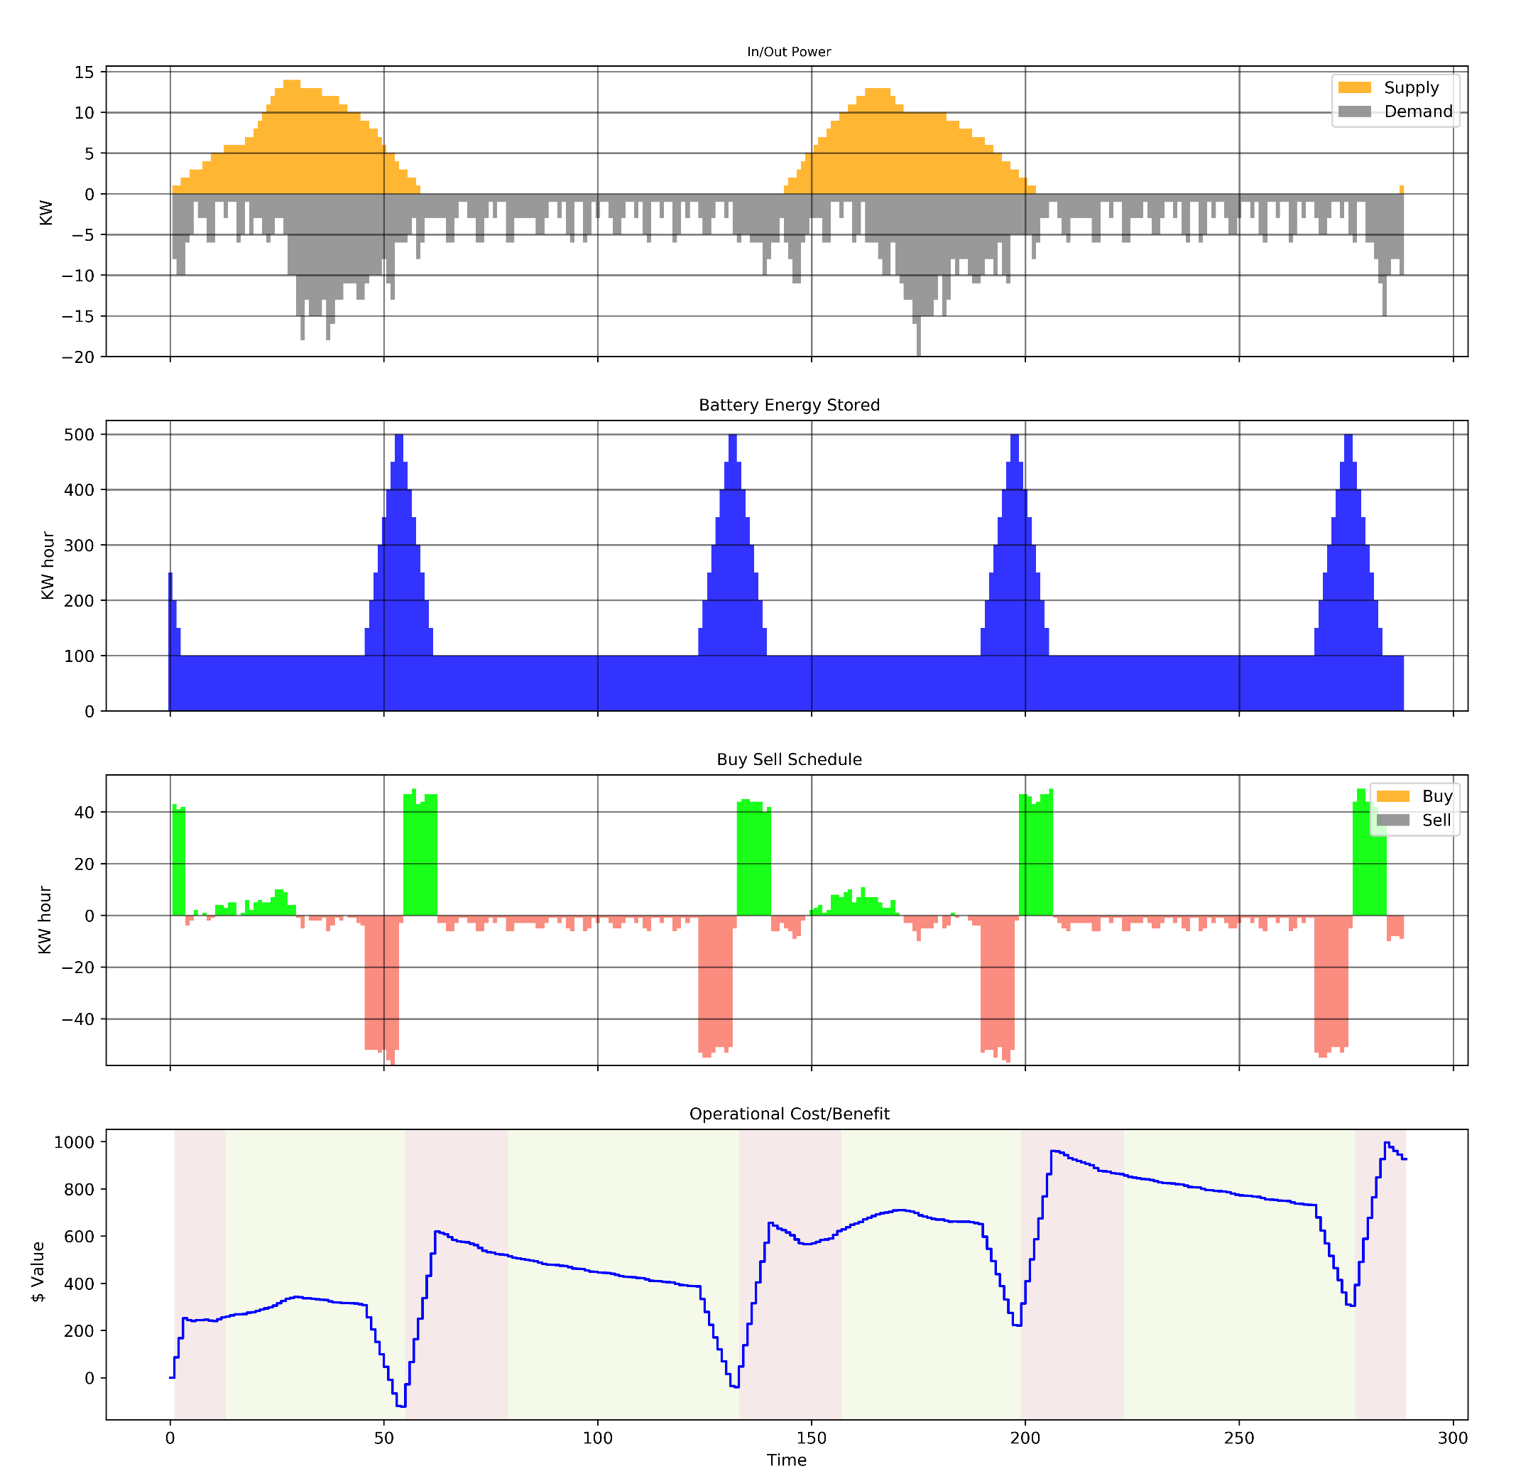
Add Battery Cost: Impose Min SOC constraint, Penalize High Charge/Discharge rate

Slide 11
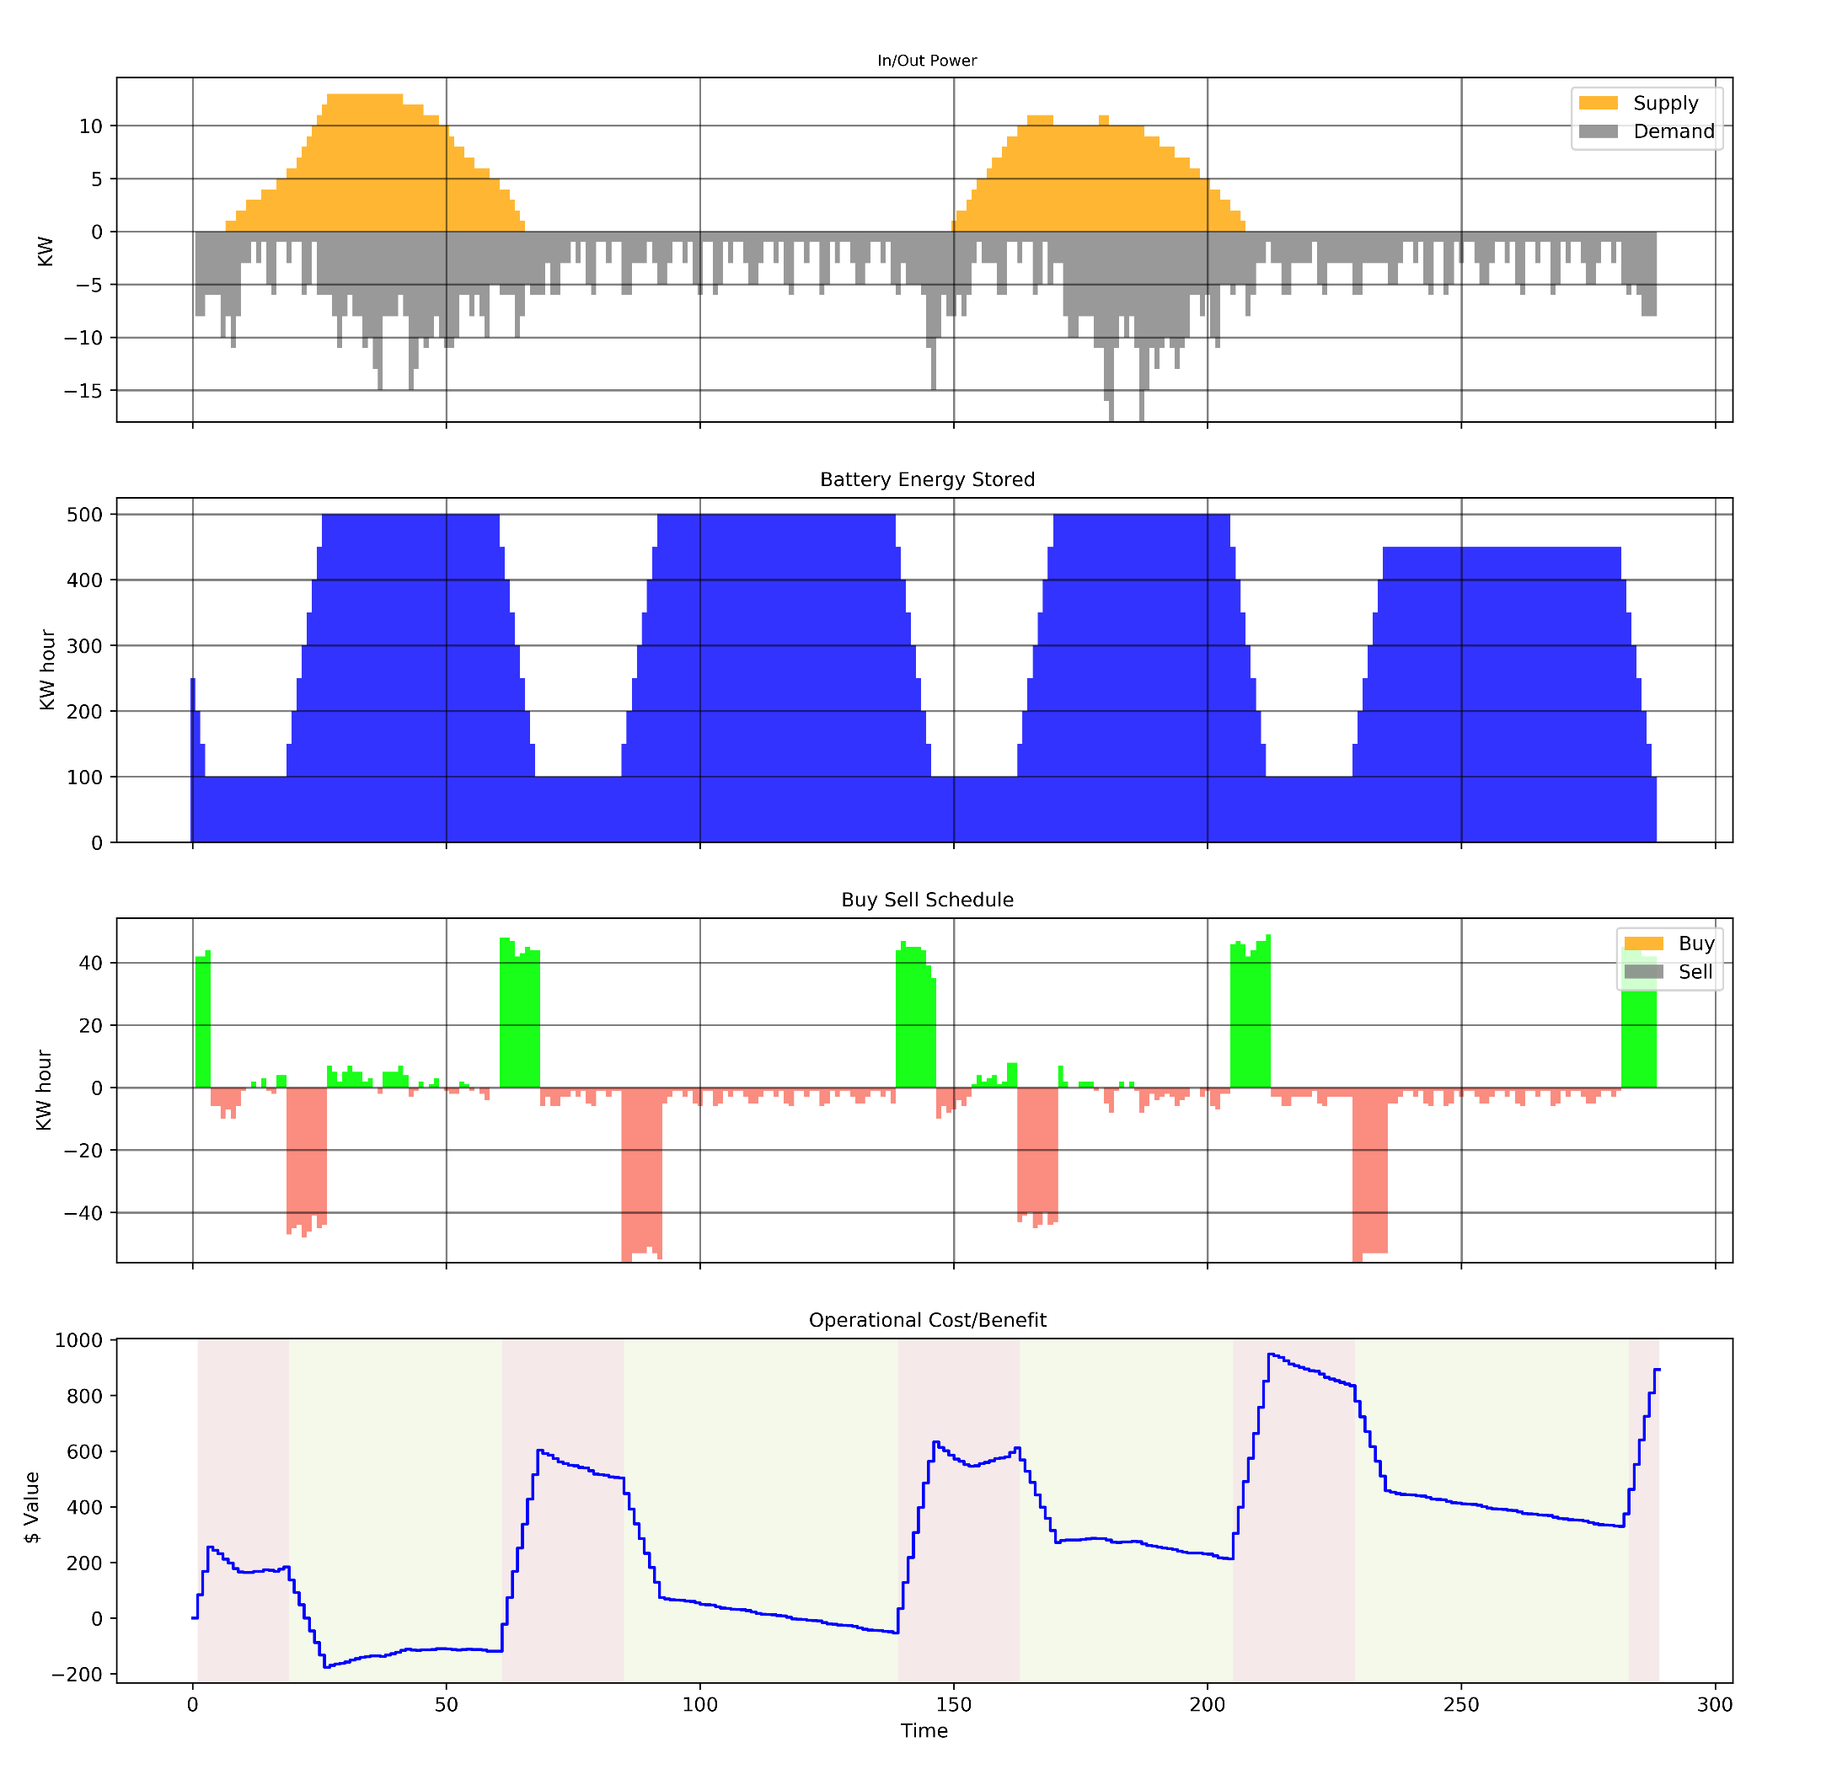
Add Preference to keep battery full

